Slide 1


Coursera Capstone IBM Applied Data Science Capstone Living in DC, planning for NYC
Nam Le
June 12, 2020

Slide 2
Business Problem
Moving from one city to another can be a stressful process, given your personality and ideal situation
I am currently living in DC, specifically in the Dupont Circle area, but have been offered an irresistible opportunity in Manhattan. I love fitness, variety of food, and parks
Objective: To analyze Manhattan neighborhoods and selected apartment units based on given criteria, preferences, and similarity to current residence, and recommend a specific unit that matches these specification
Business Question: Given geographic data, nearby venues information, and rent price distribution, can this process recommend an apartment unit that fits my needs?

Slide 3
Data
Data Required:
List of Manhattan neighborhoods (name, borough, and location data)
List of potential apartment residences (address, size, bedroom, and price)
Venue data, particularly related to gyms, food, parks, etc.
Sources of Data:
NYU data for neighborhood names
Apartment listing websites such as Rent Manhattan, Nestpick, and Realtor
Geocoder package for latitude and longitude
Foursquare API for venue data

Slide 4
Methodology
Web-scraping off websites
Integrating latitude and longitude coordinates using Geocoder
Leveraging Foursquare API for venue data
Grouping data by neighborhood and performing K-means clustering
Visualize cluster algorithm using Folium mapping
Make recommendation

Slide 5
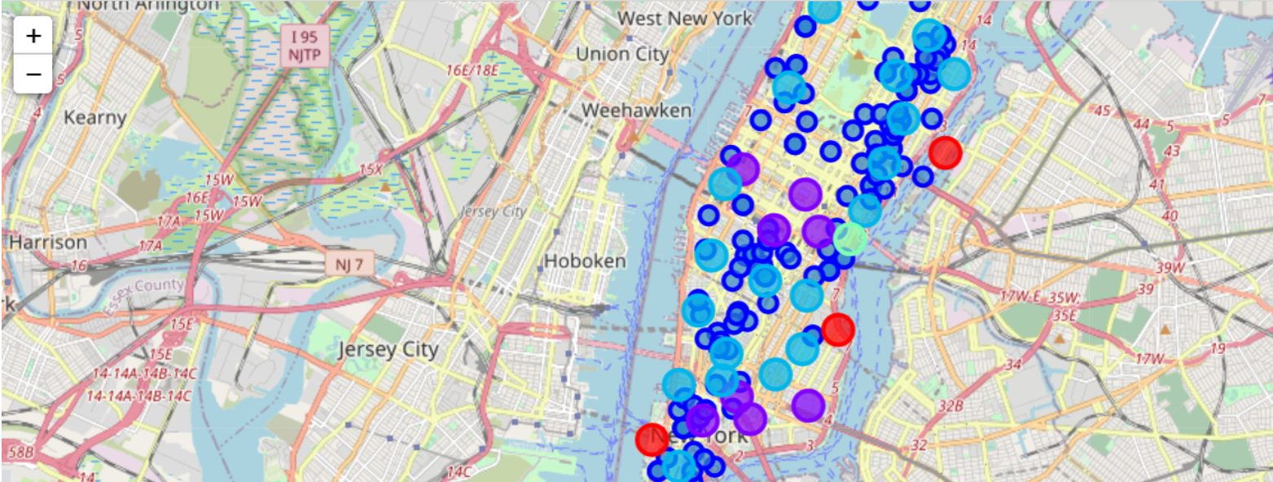
Results
Categorized neighborhoods into 5 clusters based on rent prices:
Cluster 0 is orange, Cluster 1 is purple, Cluster 2 is blue, Cluster 3 is green, and Cluster 4 is yellow (not seen because it is at the northern tip of Manhattan)
Cluster 1 is generally most expensive followed by Cluster 2, due to proximity to commercial centers

Slide 6
Discussion and Recommendation
After cluster analysis, I narrowed down my search to two apartments, one in Cluster 1 and one in Cluster 2
Apartment unit located in W 23rd St in Flatiron District is in Cluster 2, while Apartment unit in 52 Spring St in Little Italy is in Cluster 1
The first apartment costs $4250 per month, and its top venues are gyms, restaurants, and parks, while the second apartment costs $6000 per month, and its top venues are restaurants
From weighing my preferences for fitness, food options, and outdoor recreation, the first apartment makes most sense for me and matches my expectations

Slide 7
Conclusion
Answer to Business Question: Neighborhoods in cluster 2 are the best suited for me and the apartment unit located at W 23rd St in Flatiron District is the most ideal location for me coming from Dupont Circle
The results of this study will hopefully be replicated and built on to create the go-to recommender system for moving from one metropolitan to another

